Slide 1
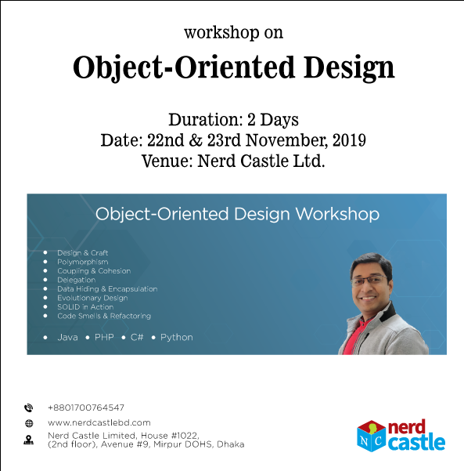

Slide 2
Timeline of Career
Programming Basics
Data Structure & Algo.
Problem Solving Skill
OOP & OOAD
Design Principles
Design Patterns
Architecture
Framework
Schooling
Career

Slide 3
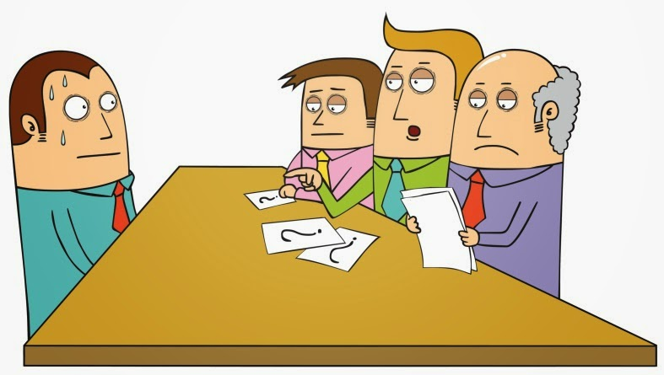
Why OOP is so important?
Why interviewers ask question about OOP, OOAD?
Encapsulation
Polymorphism
Fresh Entry (Dev)
Method overriding
Generics Association
OOP OOP OOP

Slide 4

Why OOP is so important?
What’s the hell !!! I couldn’t understand anything ☹
After joining (with little knowledge on OOP)

Slide 5


Why OOP is so important?
Why client asking for
CHANGE always?
WHY?????

Slide 6
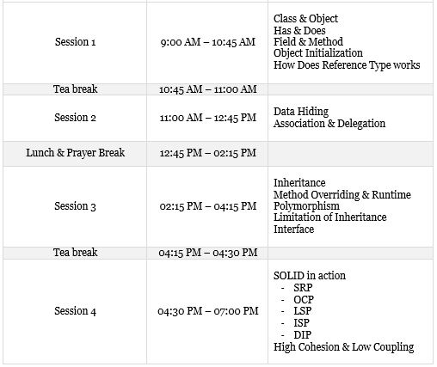

Slide 7

A Deeper dive into OOP with source code

